Slide 1
MCA105-Operating System

Slide 2
Agenda
File implementation

Slide 3
Protection
File owner/creator should be able to control:
what can be done
by whom
Types of access
Read
Write
Execute
Append
Delete
List

Slide 4
Access Lists and Groups
Mode of access: read, write, execute
Three classes of users
RWX
a) owner access 7 ⇒ 1 1 1 RWX
b) group access 6 ⇒ 1 1 0
RWX
c) public access 4 ⇒ 100

Slide 5
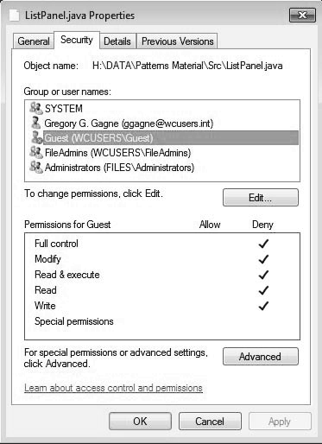
Windows 7 Access-Control List Management

Slide 6
File-System Structure
File structure
Logical storage unit
Collection of related information
File system resides on secondary storage (disks)
Provided user interface to storage, mapping logical to physical
Provides efficient and convenient access to disk by allowing data to be stored, located retrieved easily
Disk provides in-place rewrite and random access
I/O transfers performed in blocks of sectors (usually 512 bytes)
File control block – storage structure consisting of information about a file
Device driver controls the physical device
File system organized into layers

Slide 7
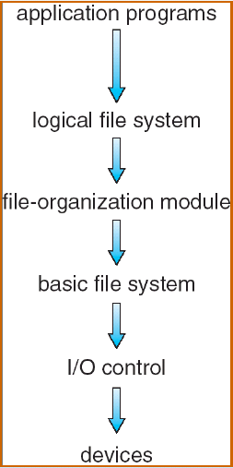
Layered file system
includes file-system structure and manages directory structure. A file control block (FCB) contains information about the file
logical block to physical block translation and also manage the free blocks on the disk
issue generic commands to device driver to read/write physical blocks on the disk, e.g., drive 3, cylinder 60, track12, sector 10
Transfer block between memory and the disk. This deals with interrupt, device drivers

Slide 8
File System Layers
Device drivers manage I/O devices at the I/O control layer
Given commands like “read drive1, cylinder 72, track 2, sector 10, into memory location 1060” outputs low-level hardware specific commands to hardware controller
Basic file system given command like “retrieve block 123” translates to device driver
Also manages memory buffers and caches (allocation, freeing, replacement)
Buffers hold data in transit
Caches hold frequently used data
File organization module understands files, logical address, and physical blocks
Translates logical block # to physical block #
Manages free space, disk allocation

Slide 9
File System Layers (Cont.)
Logical file system manages metadata information
Translates file name into file number, location by maintaining file control blocks
Directory management
Protection
Layering useful for reducing complexity and redundancy, but adds overhead and can decrease
Logical layers can be implemented by any coding method according to OS designer

Slide 10
File-System Implementation
We have system calls at the API level, but how do we implement their functions?
On-disk and in-memory structures
On-Disk structure
Boot control block contains info needed by system to boot OS from that volume
Needed if volume contains OS, usually first block of volume
Volume /Partition control block (superblock(UFS), master file table(NTFS) contains volume details
Total # of blocks, # of free blocks, block size, free block pointers or array
Directory structure organizes the files
Names and inode numbers(UFS), master file table(NTFS)
Per file FCB

Slide 11
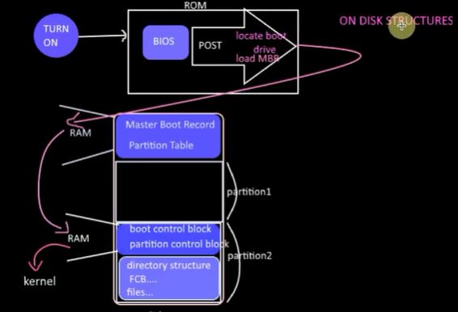

Slide 12
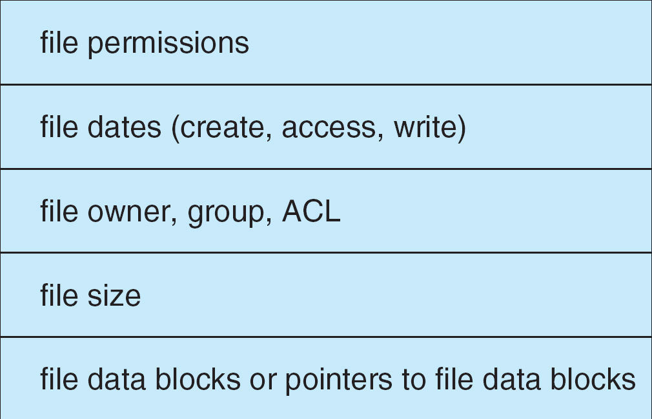
A Typical File Control Block

Slide 13
In-memory file system structure
In-memory partition table-t contains information about each mounted volume.
In-memory directory structure-directory information of recently accessed directories.
System wide open-file table-It contains the copy of FCB of each open file.
Per-process open-file table-It contains information opened by that particular process and it maps with appropriate system wide open-file.

Slide 14
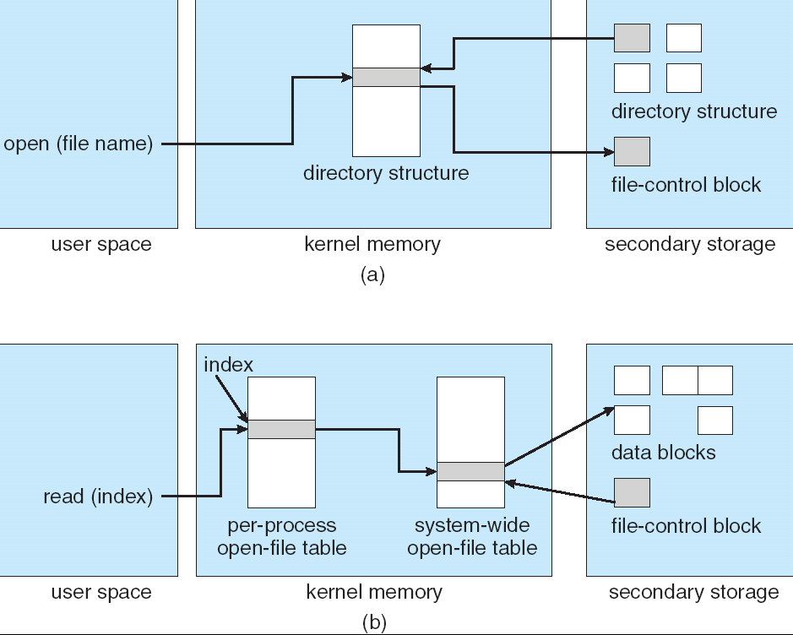
In-Memory File System Structures

Slide 15
Partitions and Mounting
Partition can be a volume containing a file system (“cooked”) or raw – just a sequence of blocks with no file system
Boot block can point to boot volume or boot loader set of blocks that contain enough code to know how to load the kernel from the file system
Or a boot management program for multi-os booting
Root partition contains the OS, other partitions can hold other Oses, other file systems, or be raw
Mounted at boot time
Other partitions can mount automatically or manually
At mount time, file system consistency checked
Is all metadata correct?
If not, fix it, try again
If yes, add to mount table, allow access

Slide 16
Directory Implementation
Linear list of file names with pointer to the data blocks.
simple to program
time-consuming to execute
Hash Table – linear list with hash data structure.
decreases directory search time
collisions – situations where two file names hash to the same location
fixed size

Slide 17
Allocation Methods
An allocation method refers to how disk blocks are allocated for files:
Contiguous allocation
Linked allocation
Indexed allocation

Slide 18
Contiguous Allocation
Each file occupies a set of contiguous blocks on the disk
Simple – only starting location (block #) and length (number of blocks) are required
Random access
Wasteful of space (dynamic storage-allocation problem)
Files cannot grow

Slide 19
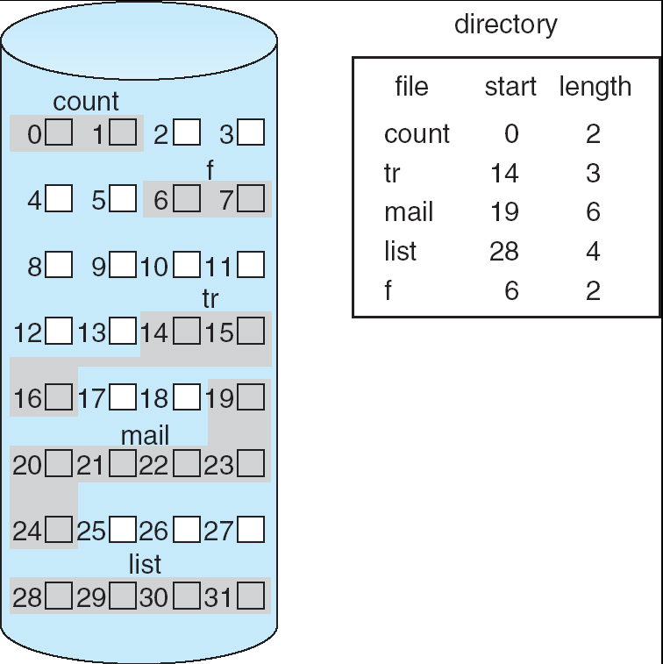
Contiguous Allocation of Disk Space

Slide 20
Extent-Based Systems
Many newer file systems use a modified contiguous allocation scheme
Extent-based file systems allocate disk blocks in extents
An extent is a contiguous block of disks
Extents are allocated for file allocation
A file consists of one or more extents.

Slide 21
Linked Allocation
Each file is a linked list of disk blocks: blocks may be scattered anywhere on the disk.
block =
pointer

Slide 22
Linked Allocation (Cont.)
Simple – need only starting address
Free-space management system – no waste of space
No random access
Mapping
File-allocation table (FAT) – disk-space allocation used by MS-DOS and OS/2.

Slide 23
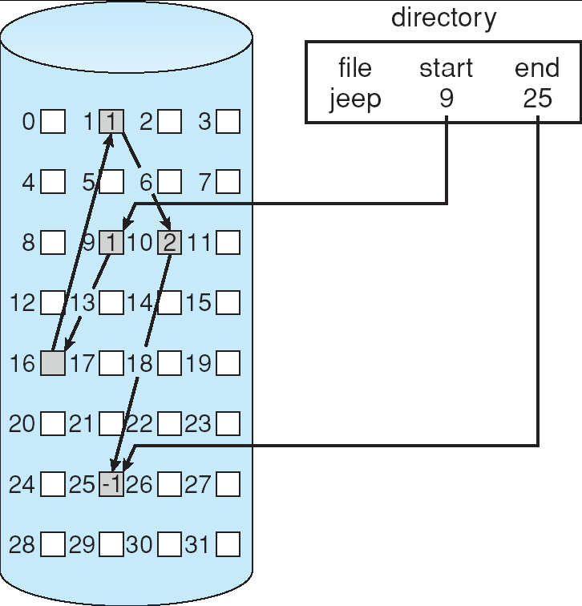
Linked Allocation

Slide 24
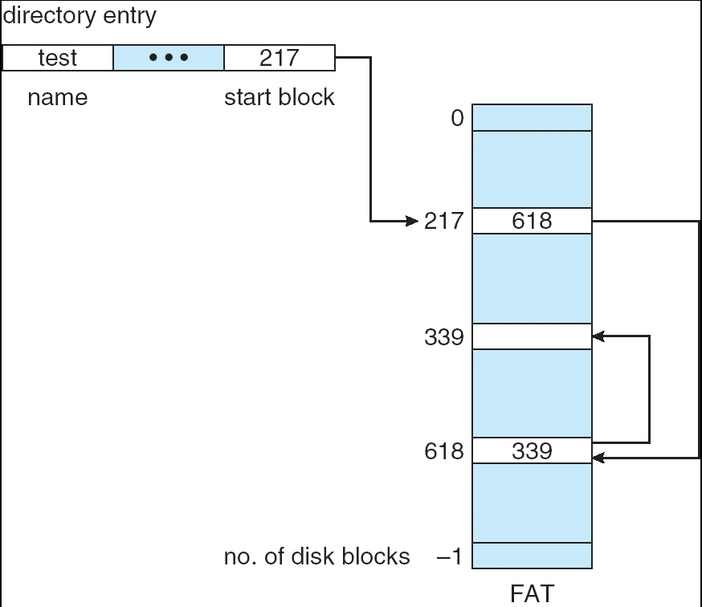
File-Allocation Table

Slide 25
Indexed Allocation
Brings all pointers together into the index block.
Logical view.
index table

Slide 26
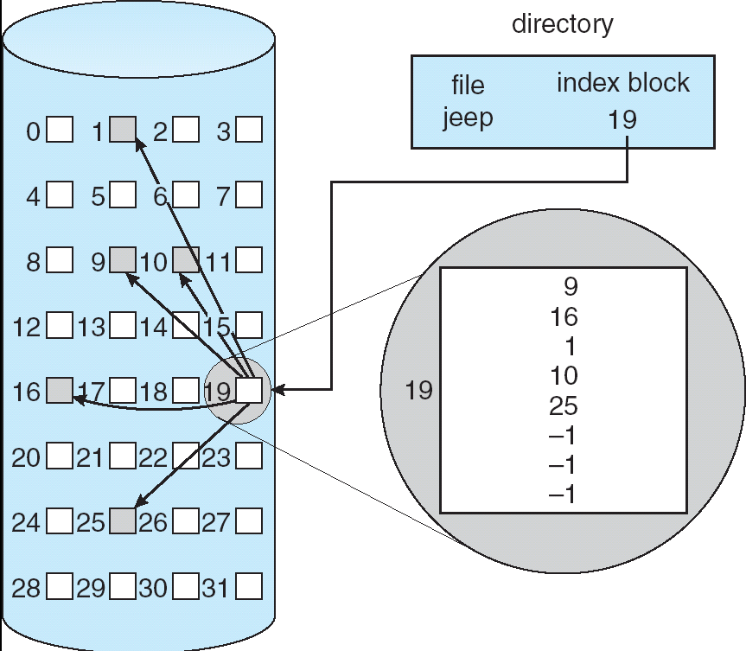
Example of Indexed Allocation

Slide 27
Indexed Allocation (Cont.)
Need index table
Random access
Dynamic access without external fragmentation, but have overhead of index block.

Slide 28
Indexed Allocation – Mapping (Cont.)

outer-index
index table
file

Slide 29
Free-Space Management
File system maintains free-space list to track available blocks/clusters
(Using term “block” for simplicity)
Bit vector or bit map (n blocks)
0
1
2
n-1
…
1 ⇒ block[i] free
0 ⇒ block[i] occupied
bit[i] =

Block number calculation
(number of bits per word) *
(number of 0-value words) +
offset of first 1 bit
CPUs have instructions to return offset within word of first “1” bit

Slide 30
Free-Space Management (Cont.)
Bit map requires extra space
Example:
block size = 4KB = 2¹² bytes
disk size = 2⁴⁰ bytes (1 terabyte)
n = 2⁴⁰/2¹² = 2²⁸ bits (or 32MB)
if clusters of 4 blocks -> 8MB of memory
Easy to get contiguous files

Slide 31
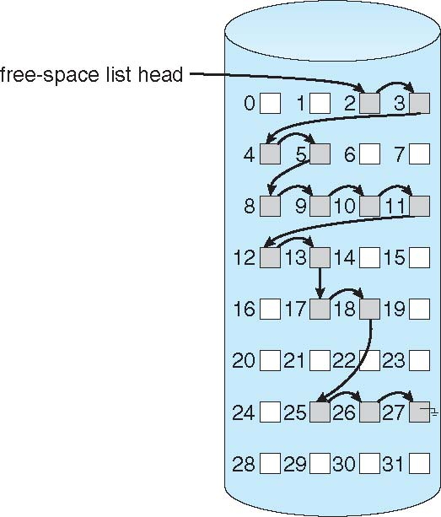
Linked Free Space List on Disk
Linked list (free list)
Cannot get contiguous space easily
No waste of space
No need to traverse the entire list (if # free blocks recorded)

Slide 32
Free-Space Management (Cont.)
Grouping
Modify linked list to store address of next n-1 free blocks in first free block
Counting
Because space is frequently contiguously used and freed, with contiguous-allocation, extents, or clustering
Keep address of first free block and count of following free blocks
Free space list then has entries containing addresses and counts

Slide 33
THANK YOU

